Slide 1
Spring Web Flux
Reactive Programming
By Rohan and Ashish

Slide 2
What is Reactive Programming ?
Reactive programming describes a design paradigm that relies on asynchronous programming logic to handle real-time updates to otherwise static content. It provides an efficient means -- the use of automated data streams -- to handle data updates to content whenever a user makes an inquiry.

Slide 3
Why Reactive Programming ?
The RP helps developers to increase the performance of an app as it can process big volumes of data very quickly. The RP modules are :
More flexible
Resilient and scalable
More tolerant of failure
Use resources efficiently
Less latent
Highly responsive

Slide 4
A responsive web application is both scalable and resilient. Responsiveness is impossible to achieve without both scalability and resilience.

Slide 5
Low Latency
Low latency describes a computer network that is optimized to process a very high volume of data messages with minimal delay (latency). These networks are designed to support operations that require near real-time access to rapidly changing data.

Slide 6
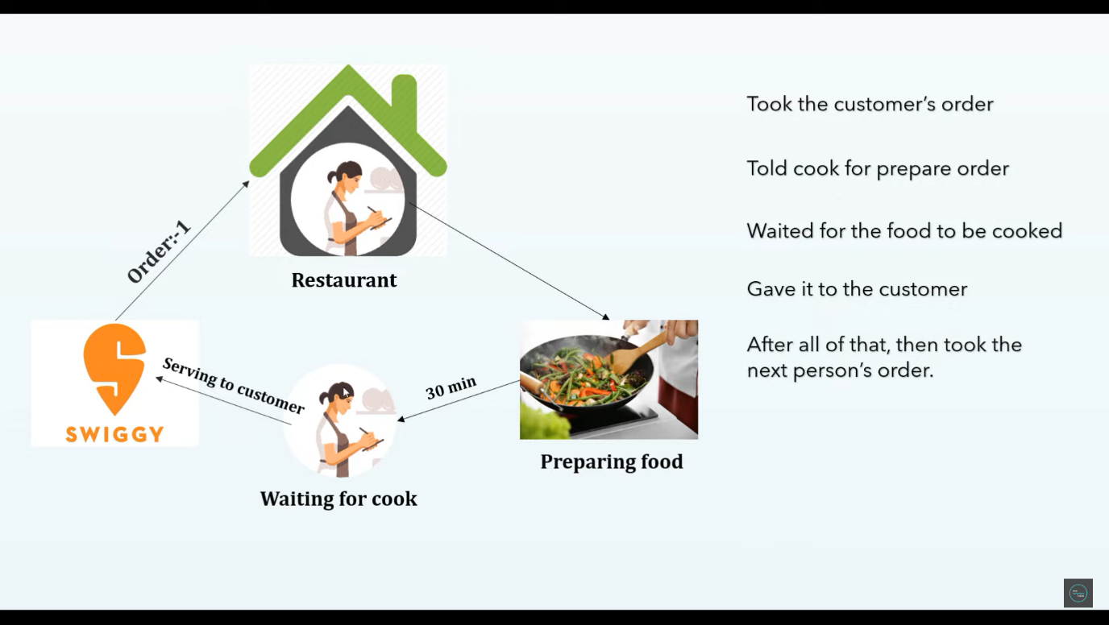
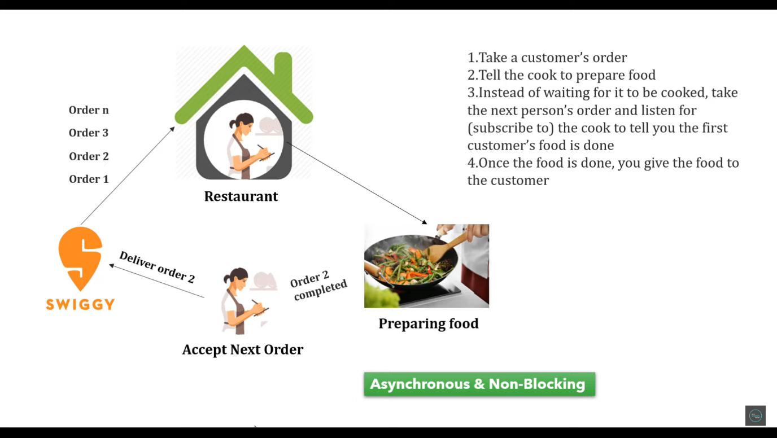
Comparison
Web Servlet (MVC)
Web Reactive (WebFlux)

Slide 7
Differences
Web Servlet (MVC)
Web Reactive (WebFlux)
Servlet
Tomcat
JDBC
Data JPA
All NoSQL
Without Servlet
Netty
R2DBC
N/A
Mongo DB

Slide 8
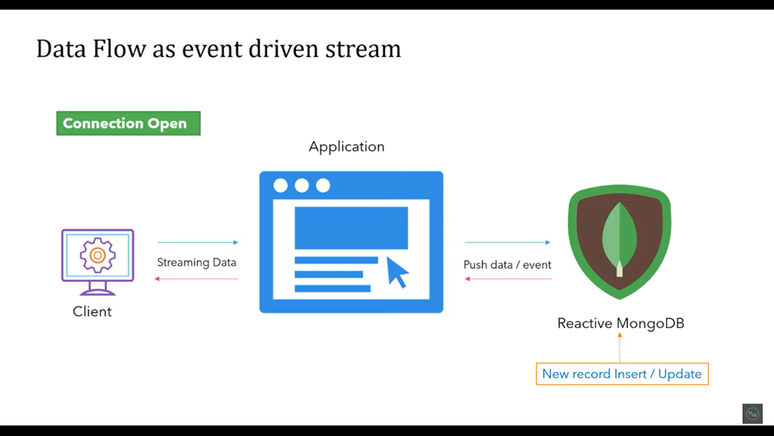

Slide 9
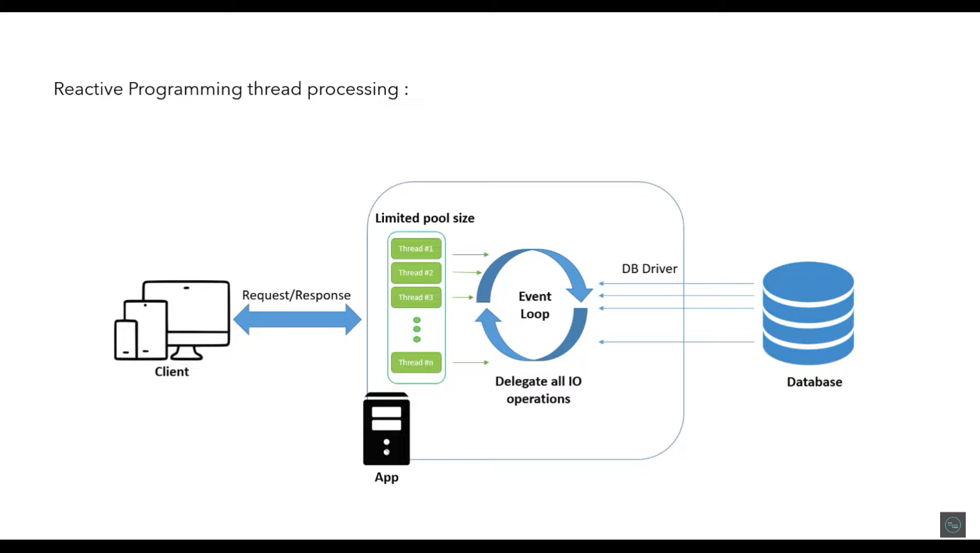

Slide 10
Advantages of using Flux
Flux manages complicated interactions between data resources.
Flux has a unidirectional data flow which means it is easier to manage the data flow.

